Slide 1
Kidney fibrosis classification using modified vgg11
Leonardo daou
Manel R. Benabid

Slide 2
Introduction
Kidney Fibrosis is one of the chronic disease that is affecting 10% of the world’s population and the number of people afflicted by it is growing.
Older techniques to diagnose is through biopsy which would result in many complications for the patient.
Newer techniques for diagnosis is through imagery like ultrasound images. The professional would then classify by eye.

Slide 3
Introduction
The problem is that image quality is not good enough for all experts to have the same opinion about the progression of the disease or if there actually is one.
Hence, machine learning is the way to go forward.

Slide 4
Data
Data was collected from 31 mice with 11 images for each one of them. These 31 mice were split into three classes depending on the state of the progression of the fibrosis. This results in 88 images for control, 99 for mild, and 154 for severe cases. The problem with the imagery data in this case is the noise affecting it even though we can clearly see the points of interest if we plot a heatmap of images from each class.

Slide 5
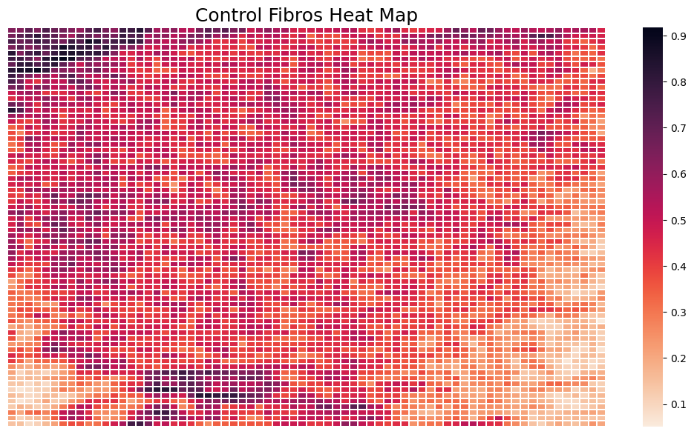
Data

Slide 6
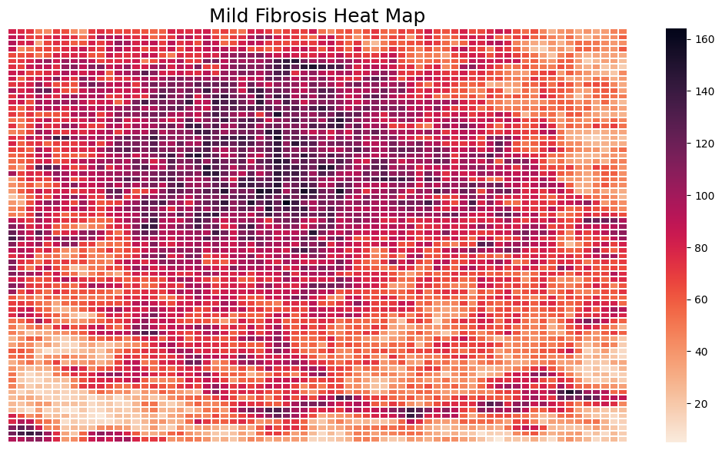

Slide 7
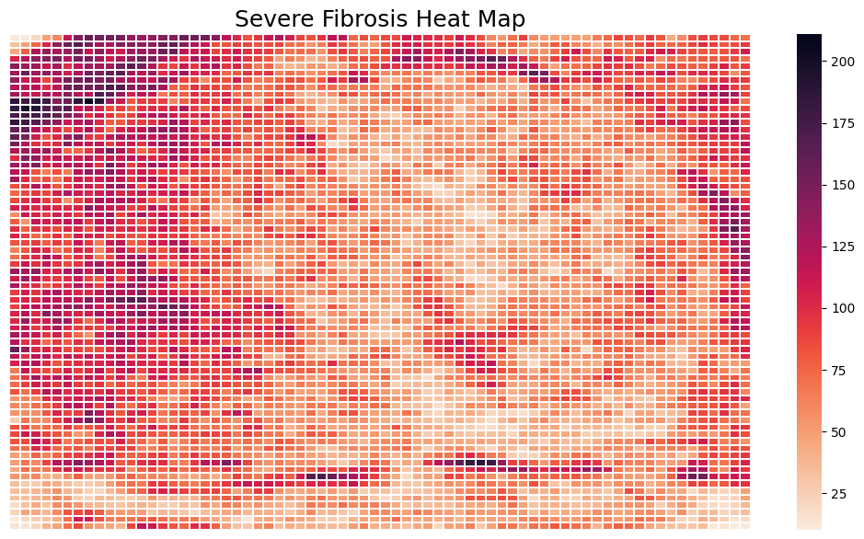

Slide 8
Data Preprocessing and augmentation
Preprocessing:
Normalized
Standardized
Other methods like denoising and sharpening the images did not help
Augmentation:
Flipping vertically and horizontally
Zoom of 0.1

Slide 9
Method proposed
Another work used VGG11 in order to get classify liver fibrosis which also had ultrasound imagery. The only difference is that they had a region of interest whereas we do not have it from what we can see in the above images from the noise.
VGG16 and VGG19 were tried but they led to vanishing gradients.

Slide 10
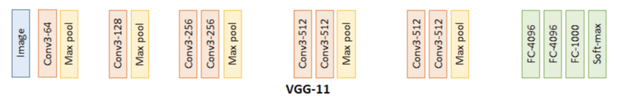
Method Proposed
VGG11 Architecture

Slide 11
Method proposed
In order to better use the transfer learning model, we removed the fully connected layers from VGG11 and replaced it with one dense layer that had 500 neurons and another with 200 neurons. Both have sigmoid activation function and the first one was followed by a ReLU activation function to lessen the vanishing gradient effect.
Both hidden layers had a dropout of 0.6.
The output was a softmax layer with 3 neurons.

Slide 12
Method proposed
Optimizer: SGD with two learning rates
First learning rate is 0.001 with decay until it reaches 0.0001. This is for the convolution part since we want to fine-tune.
Second leaning rate is 0.01.
Both have momentum of 0.9.
Loss: Binary Crossentropy
Epochs: 100

Slide 13
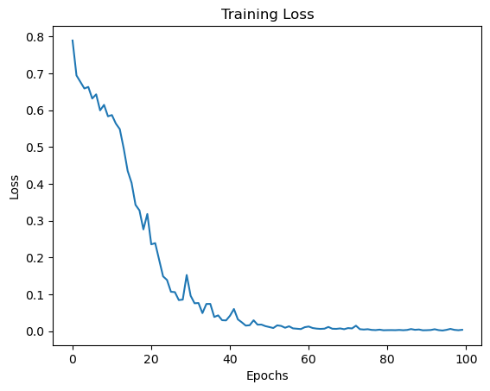
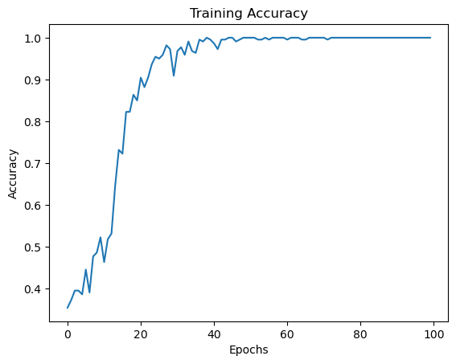
Results

Slide 14
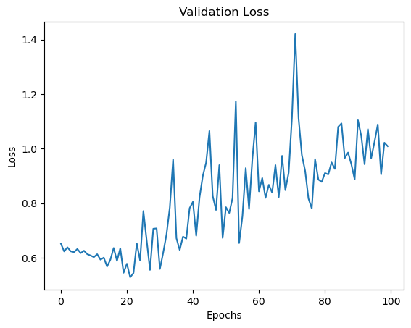
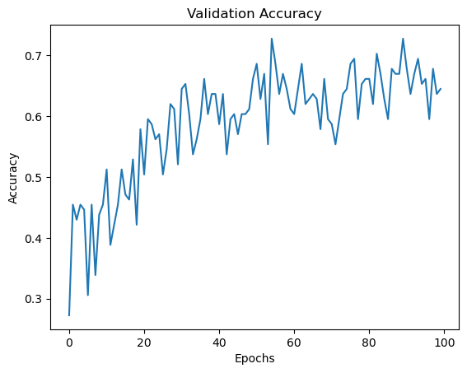
Results

Slide 15
Results
Accuracies on the 3 splits:
0.7107438016528925
0.6611570247933884
0.6611570247933884
Average on Test:
Precision: 0.6915630107662544
Recall: 0.6707070707070707
F-measure: 0.6743373393881292
Accuracy: 0.6776859504132231

Slide 16
Limitations and future work
One method that did not work and gave us a very early saturation is using GA to optimize the weights of the network. It would be good to try and use it to optimize other aspects of the network or use another search base algorithm.
One limitation is the data being noisy and images of control and early stage having very similar properties. This lead to overfitting which is a problem that needs to be overcome.

